Slide 1

American Airlines – Cargo Performance & Flight Data Analysis

Slide 2

Previous Business Intelligence Reports:

Slide 3
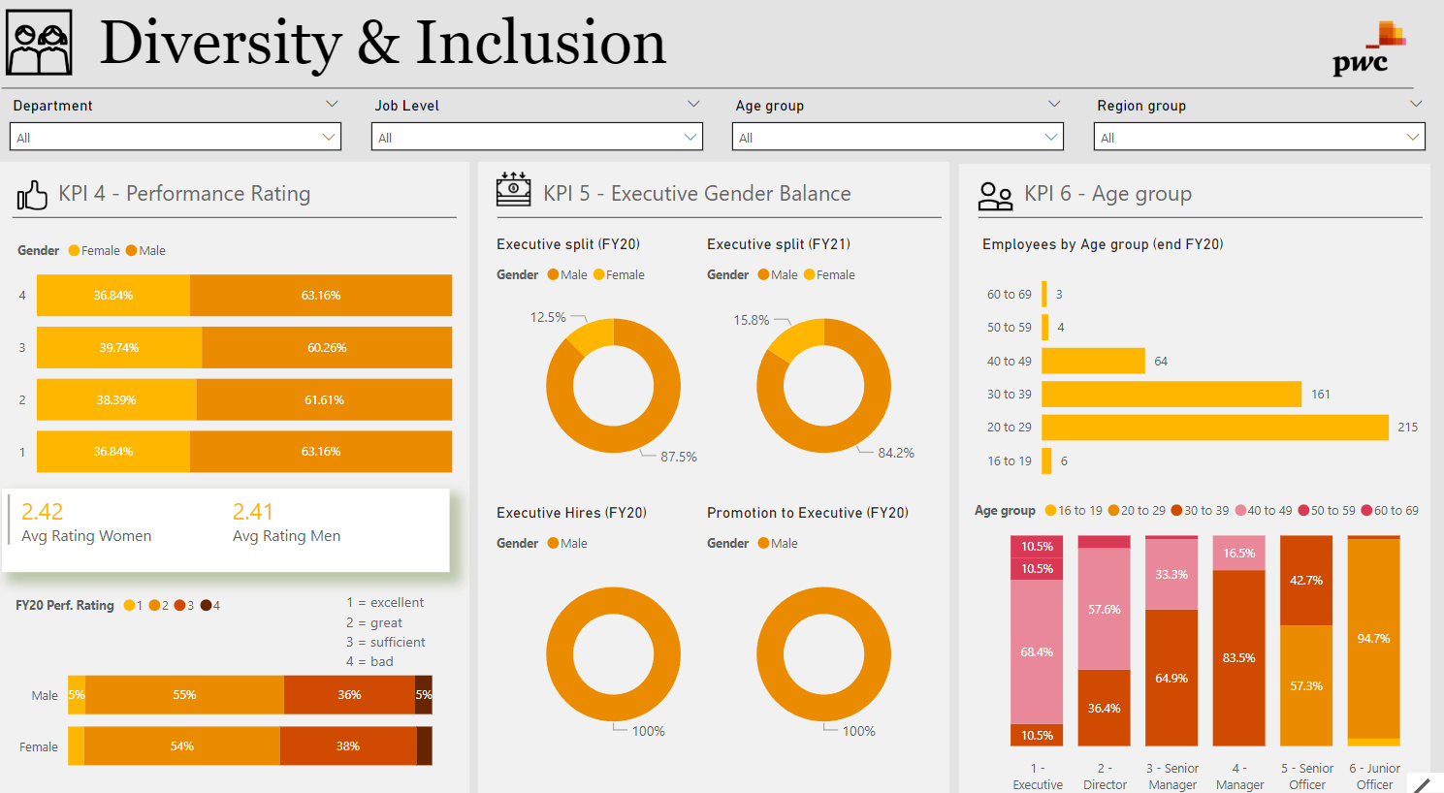

Slide 4
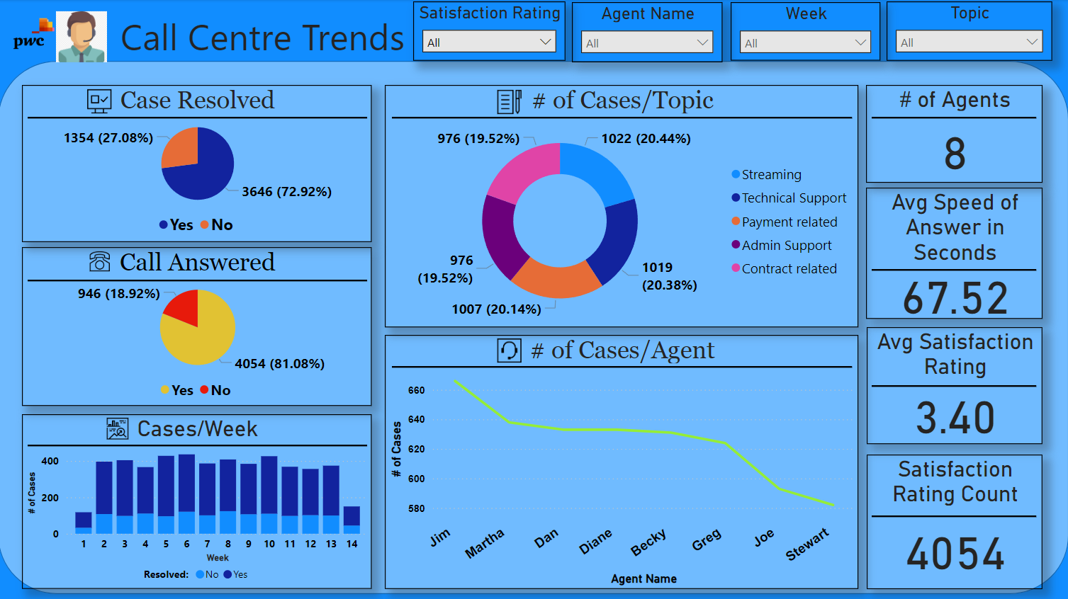

Slide 5
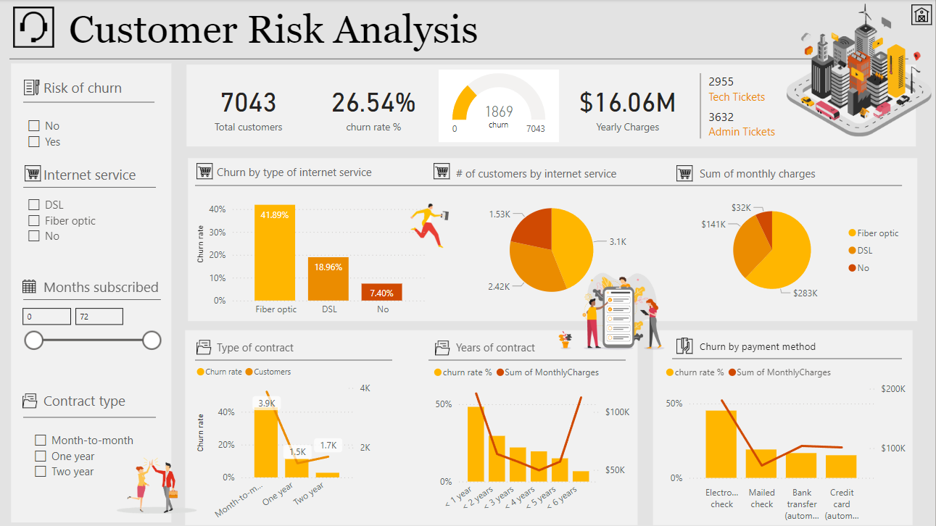

Slide 6
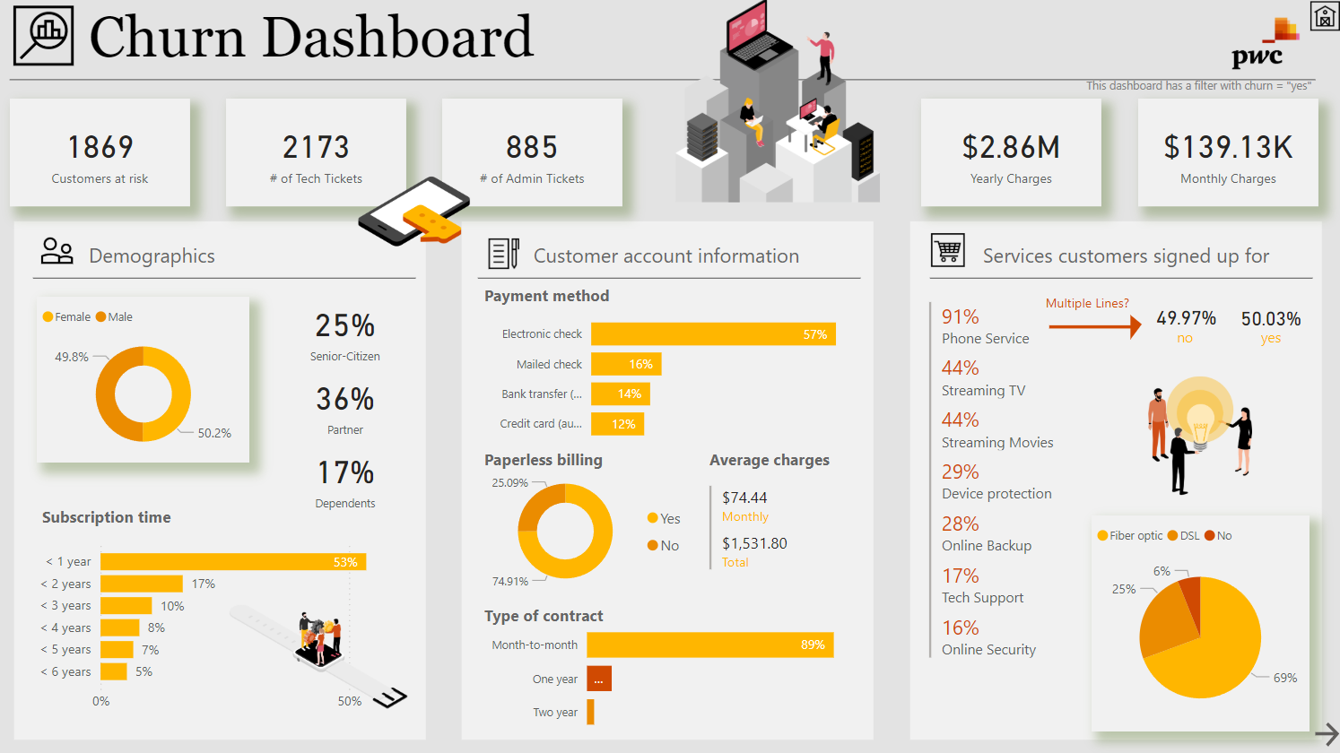

Slide 7

Objective:
Task 1: Cargo Performance Analysis
Task 2: Building predictive models to help United Airlines acquire customers
Task 3: Sentiment Analysis of customer reviews/feedback to better understand customer feelings, opinions, and needs.

Slide 8

Skills Used:
Machine Learning – Random Forest, Neural Network, Logistics Regression
BI Tool – Microsoft PowerBI
Python/R Programming
Web Scrapping
Alteryx Designer
Microsoft Excel
Microsoft PowerPoint

Slide 9

Task 1: Cargo Performance Analysis

Slide 10
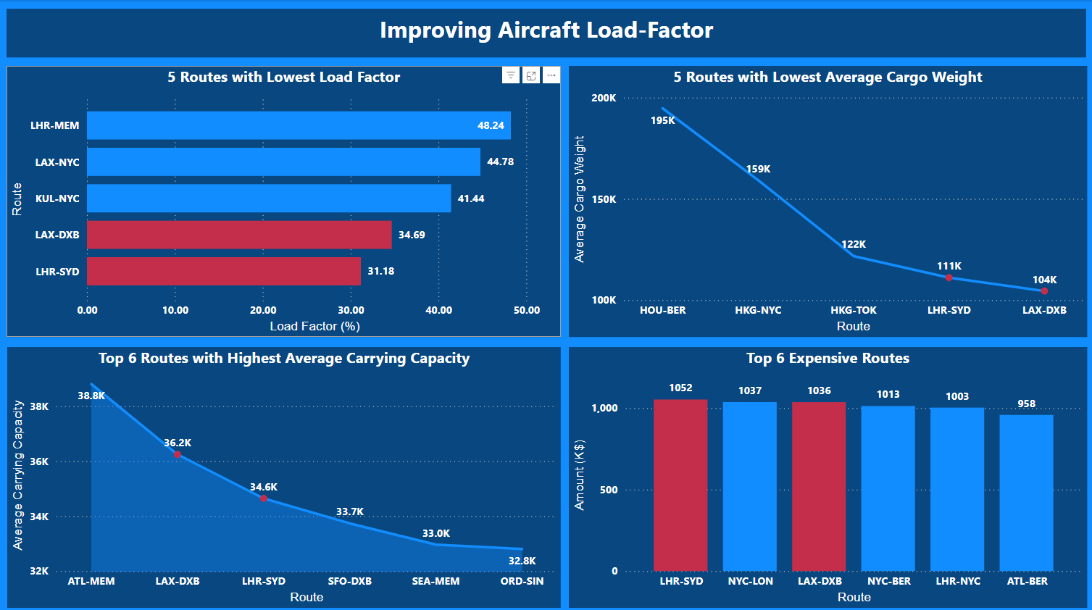

Slide 11
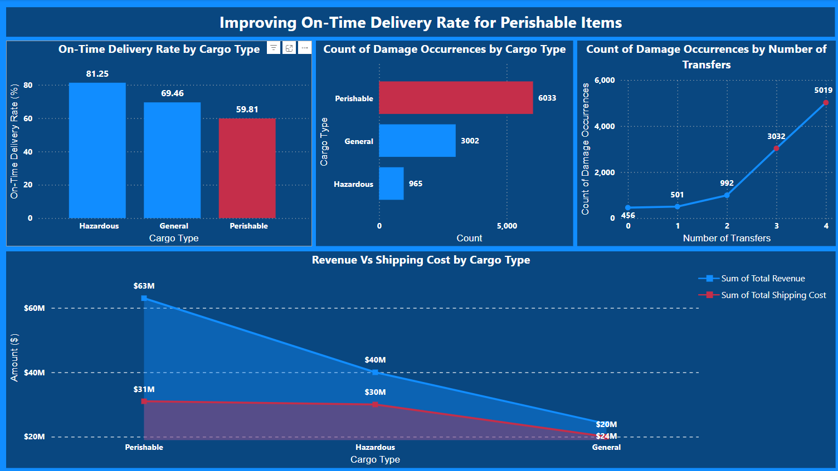

Slide 12
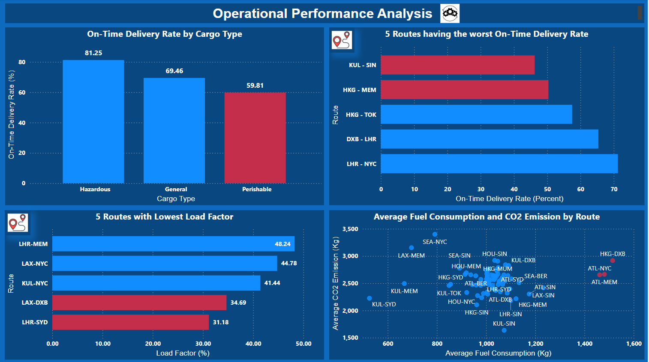

Slide 13
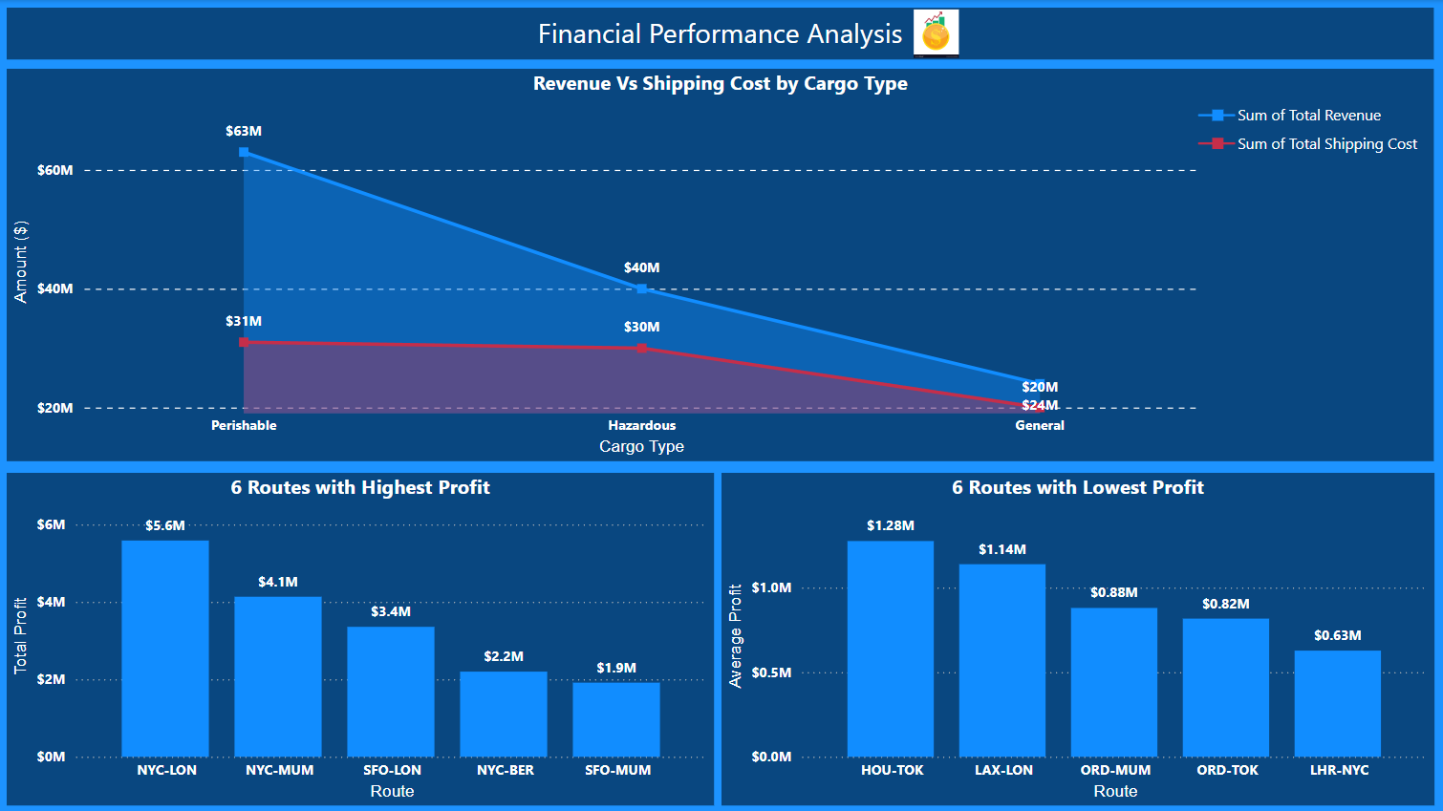

Slide 14

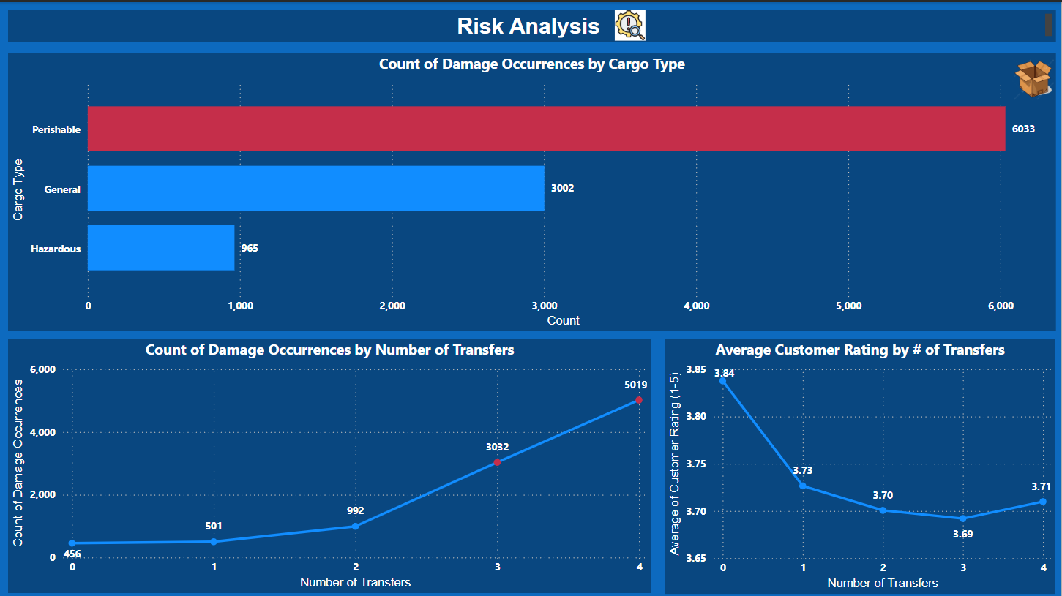
Environmental Performance KPIs
Carbon Emissions per Ton Kilometer: Measures the environmental impact of cargo operations.
Fuel Efficiency: Cargo transported per unit of fuel consumed.

Slide 15
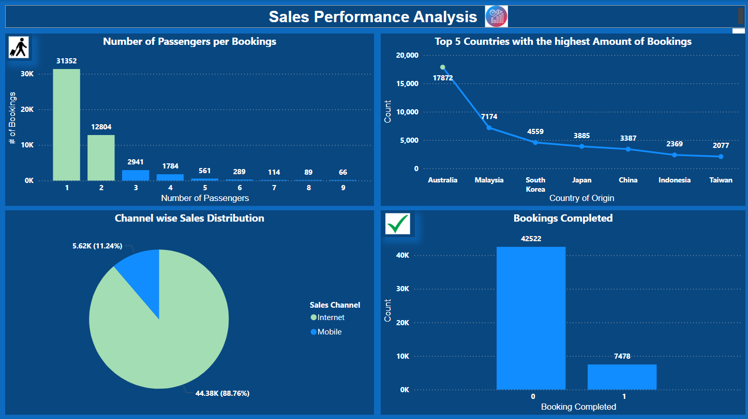

Slide 16

Types of Analysis:
Operational Performance Analysis – On-Time Delivery Rate, Transit Time Analysis, Resource Utilization, Load Factor, Loading & Unloading Time
Customer Insights - Customer Ratings, Service Feedback
Financial Performance - Cost vs. Revenue Analysis, Damage Costs
Risk Analysis - Damage Occurrences, Transfer Risks
Route Optimization - Origin-Destination Pair Analysis, Seasonality Insights
Sustainability Goals - Carbon Footprint Analysis, Fuel Efficiency
Predictive and Advanced Analytics - Forecasting Demand, Risk Prediction Models
Visualizations for Insights - Heat Maps, Trend Charts
Strategic Planning - Performance Benchmarks, Cost-Benefit Analysis of Investments

Slide 17

Key Performance Indicators: Cargo Performance

Slide 18

Operational Performance KPIs:
Cargo Volume: Indicates the total amount of cargo handled.
Cargo Load Factor (CLF): Reflects the percentage of available cargo space utilized.
Freight Yield: Measures the revenue earned per ton of cargo transported per kilometre.
Turnaround Time (TAT): Measures the time taken to load, unload, and prepare a cargo aircraft for its next flight.
On-Time Delivery (OTD): Percentage of cargo delivered within the promised timeframe.
Warehouse Dwell Time: Measures the average time cargo spends in storage facilities before being shipped or picked up.

Slide 19

Financial Performance KPIs
1. Revenue Ton Kilometer (RTK): Measures the revenue-generating distance a ton of cargo is flown.
2. Cost per Ton Kilometer (CTK): Total costs incurred for transporting one ton of cargo over one kilometre.
3. Profit Margin: Net revenue from cargo operations as a percentage of total revenue.
4. Unit Cost of Handling: Cost incurred to process a cargo unit.

Slide 20

Customer Satisfaction KPIs:
1. Customer Complaint Rate: Number of complaints per shipment or month.
2. Delivery Accuracy: Percentage of shipments delivered to the correct destination without issues.
3. Claims Ratio: (Total value of claims / Total revenue). Indicates the frequency and value of cargo damage or loss.

Slide 21

Market & Business KPIs:
Market Share: Percentage of the market controlled by the cargo operation.
Route Profitability: Revenue minus costs for specific cargo routes.
Utilization Rate: Measures the degree to which cargo handling assets (e.g., forklifts, storage facilities) are utilised.

Slide 22

Sales Performance KPIs:
Average Revenue Per Unit (ARPU): Formula: (Total Revenue / Number of Units Sold). Tracks the average earnings per product or service sold.
Lead Conversion Rate: Formula: (Number of Converted Leads / Total Leads) × 100. Measures the efficiency of converting leads into paying customers.
Cost of Customer Acquisition (CAC): Indicates the investment needed to acquire one new customer.
Churn Rate: Measures customer attrition over a given time.
Customer Lifetime Value (CLV): Predicts the total revenue a customer will generate during their relationship with the business.

Slide 23

Conclusion & Recommendation:
Focus on improving the On-Time Delivery Rate of Perishable items by reducing the number of transfers. This will help improve the delivery rate and customer satisfaction and reduce cargo damage occurrences and costs associated with transfers & damages (thereby increasing profit margin).
The lower On-Time Delivery Rate on KUL-SIN & HKG-MEM routes is because these routes have the highest air traffic worldwide, which can delay cargo delivery. Diverting the time-critical cargo (such as perishable cargo) to other routes can help increase the on-time delivery rate for perishable items and improve CSAT (Customer Satisfaction Score).

Slide 24
Conclusion & Recommendation:
LHR-SYD & LAX-DXB have the lowest load factor, which can be attributed to lower freight demand on these routes; high capacity aircrafts operated on these routes. Operate lower-capacity aircraft or divert cargo from other in-demand routes to efficiently use the available cargo space and improve the On-Time Delivery Rate.
HKG-DXB, ATL-NYC & ATL-MEM routes have high CO2 emissions and fuel consumption. This can be due to older aircraft operating on these routes, which are not fuel efficient or working on older emission systems. Use state-of-the-art aircraft to help reduce fuel costs/consumption (increase profit) and be in compliance with the CO2 emissions set by the environmental body.

Slide 25
Conclusion & Recommendation:
3. Australia, Malaysia & South Korea were the countries most bookings came from. As mentioned, the economies of these countries are doing well, with strong GDP growth and inflation under control. Increase the ad campaign penetration in these countries to improve the ROMI (Return on Marketing Investment) and achieve the sales target.
4. The current sales conversion rate is very low at 15%. Implementing the above strategies can help increase the sales conversion rate.

Slide 26

Task 2: Customer Buying Behaviour

Slide 27

Objective: Train a Machine Learning model to predict whether a customer will make a booking. Also, output information about the top 5 important variables that are crucial for the prediction.
Classification-based Machine Learning Model Trained –
Random Forest
Neural Networks
Logistic Regression
Model Evaluation Metrics – Accuracy, Confusion Matrix, Lift/ROC.
Used R programming to build these Machine Learning models.

Slide 28

Random Forest/Boosted Trees:
Target Variable – booking_complete (whether the customer completed the transaction)
NodeSize – 20, ntree – 900. These values were finalised by calculating & selecting the value with the lowest Out-Of-Bag Error.
The Out-of-Bag (OOB) Error Rate is a key metric used in Random Forest models to estimate their performance without needing a separate validation dataset. The OOB error for the final model came out to be 14.82%.
Also calculated the confusion matrix on the validation dataset. Summing the Sensitivity (True Positive) & Specificity (True Negative), we get an accuracy of 85.11%.
Plotted the variable importance plot. According to the plot, Origin location, flight route, Length of Stay, Flight Duration, Sales Channel, and Extra Baggage were the top 6 factors with the most predictive power.

Slide 29
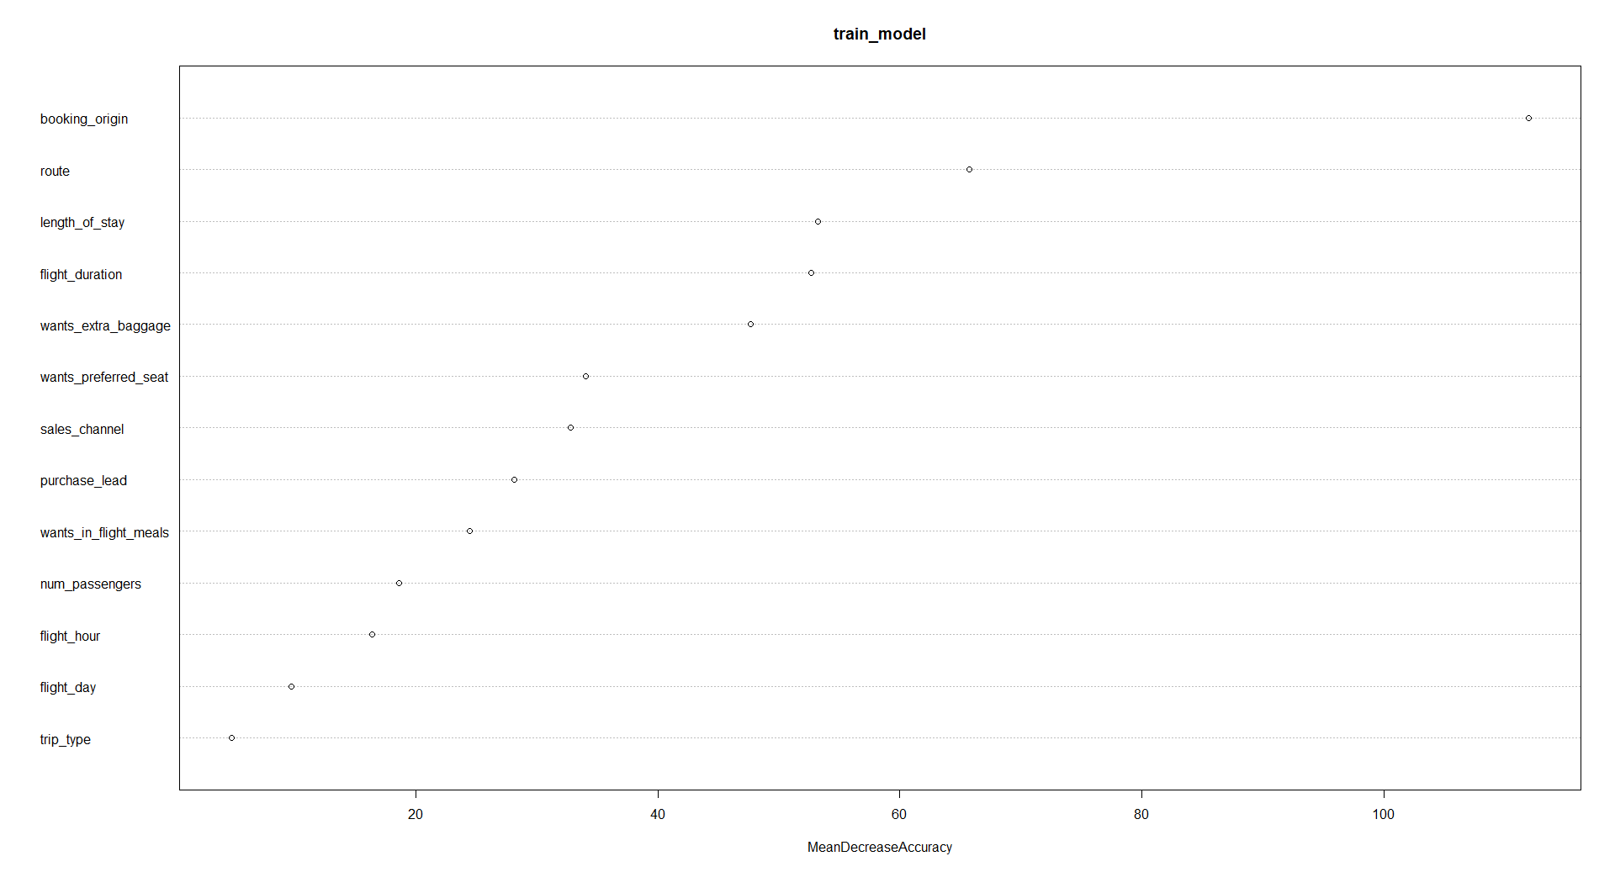
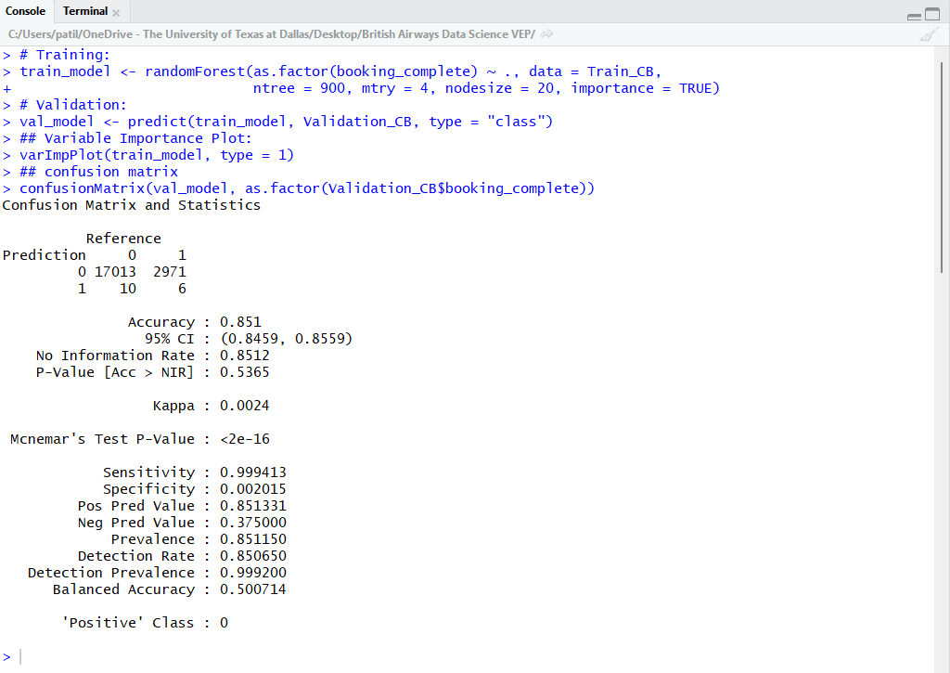

Slide 30
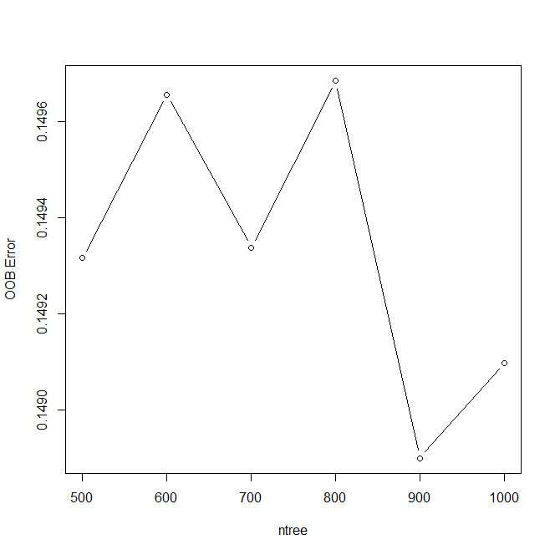
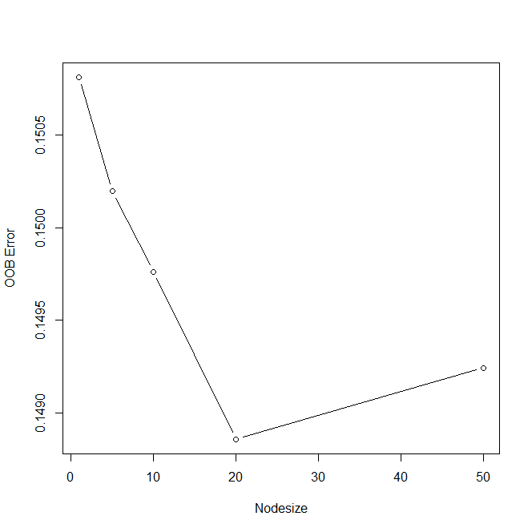

Slide 31

Neural Networks
Data Pre-Processing – Data Partitioning into Training & Validation Datasets, Converting Categorical Variables to Numeric, and Data Normalization.
Model Parameters – Hidden Layers = 4, Threshold = 0.001, Learning Rate = 0.05, StepMax = 50000.
Trial and error methods were used to select the parameters. Start with the ideal values and adjust until the model converges.
Calculated the Confusion Matrix which gave the Accuracy – 84.79%.

Slide 32

Logistics Regression
According to the model, Origin location, Flight Duration, Extra Baggage, Sales Channel, and Length of Stay were the top 5 factors that had the most predictive power/importance in predicting whether the customer would complete the booking or not.
Both the models (Random Forest & Logistic Regression) generate the same list of the Top 5 variables of importance.
Given the customer information we can predict whether the customer will book the holiday/ticket.

Slide 33
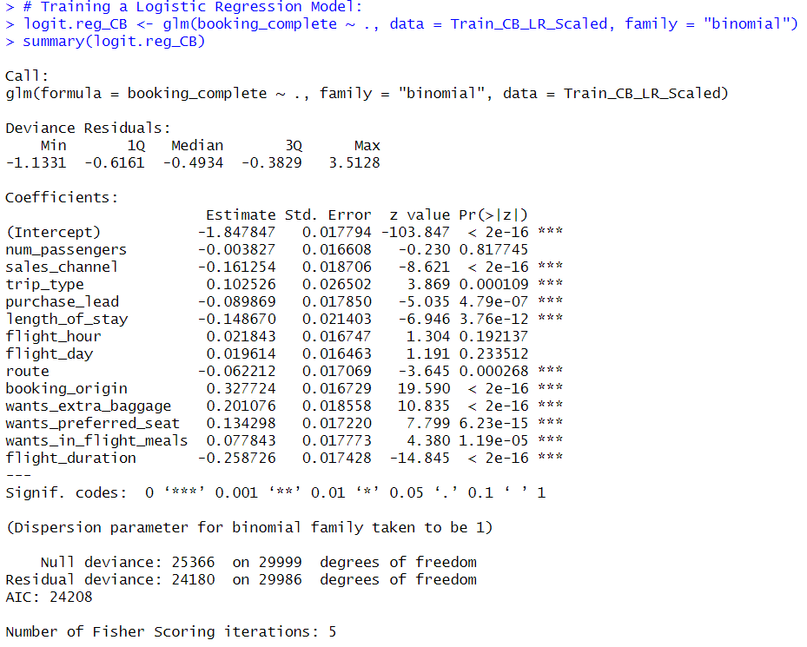

Slide 34
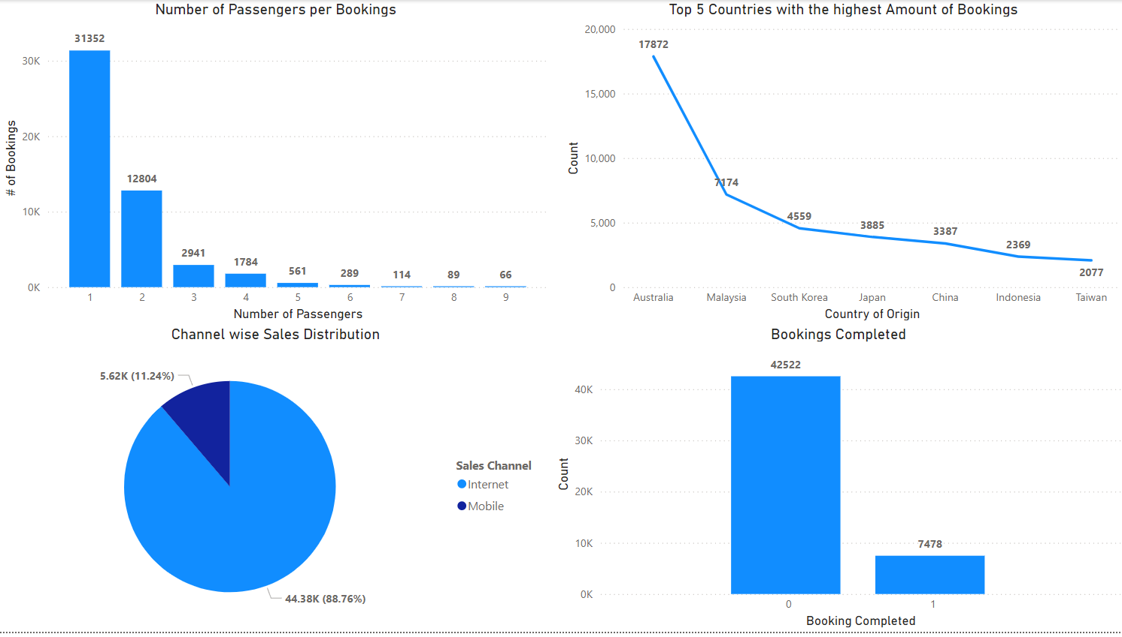
Sales Performance:

Slide 35
Conclusion & Recommendation:
1. 89% of the holiday bookings were booked by customers travelling solo or as a couple. Tailoring holiday packages suitable for these two categories can help improve the CAR (Customer Acquisition Rate) & sales bookings.
2. 88% of the customer bookings came from the Internet (Sales Channel) compared to Mobile. Since the booking share is very low for Mobile, diverting the ad budget and other resources from Mobile to the Internet can help to make efficient use of the financial resources and increase CAR.

Slide 36

Task 3: Sentiment Analysis on Customer Feedback Data

Slide 37

Scraped and collected customer feedback data from the Skytrax website using Python & BeautifulSoup.
Analysis was performed on feedback data, such as sentiment analysis, topic modelling, and Word Cloud.
Sentiment Analysis was done using R programming.
There were 2699 positive reviews, 1179 negative reviews & 20 neutral reviews.
Used Alteryx for Topic Modeling & Word Cloud generation.

Slide 38
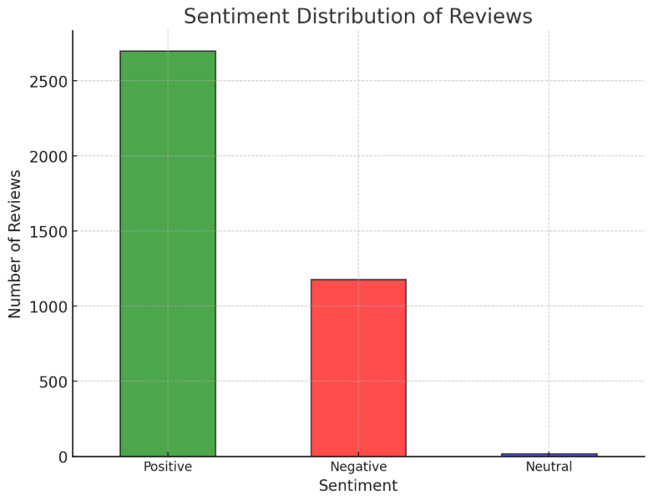

Slide 39

Why We Are a Perfect Match:
Masters in Business Analytics & Artificial Intelligence
Experience BI tools Power BI and Tableau
3 years of work experience in the field of Data Analytics at Vodafone working on Qlik, Alteryx Designer, Gallery, and Server.
Experience working on projects related to Airlines/freight forwarding. I can anticipate the type of work I will be doing. Less Supervision. I stay in Dallas. Can work from DFW office.
Work Experience in Logistics & Supply Chain (LG Electronics & at an EV based start-up).
Experience in R, Python, and SQL programming, Excel & PowerPoint
Research Projects & Publications based on AI/ML
Google Data Analytics Professional Certificate – Half Done
Applied Machine Learning, Applied Deep Learning, Big Data, Prescriptive Analytics, Business Analytics with R, Database Foundations, Advanced Statistics

Slide 40

Thank You
“You Are Why We Fly”

